Slide 1
Top 5 countries YOU must visit

Slide 2
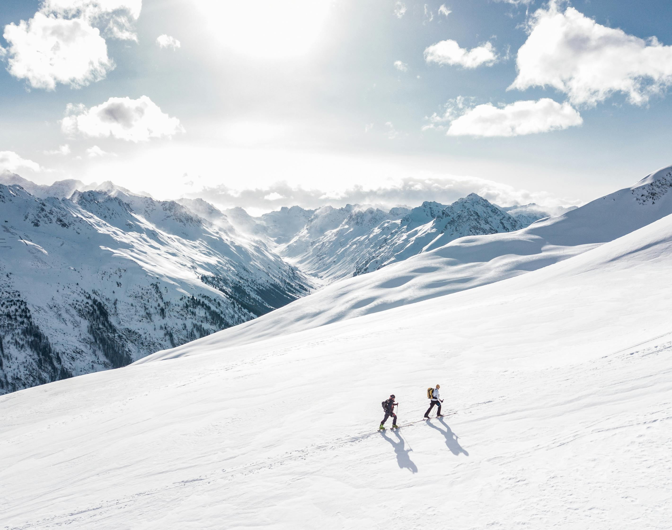
New Zealand
Known as the "Adventure Capital of the World," New Zealand boasts breathtaking landscapes, including fjords, mountains, and pristine beaches.
Adventure activities include bungee jumping, skydiving, hiking in Fiordland National Park, and exploring the geothermal wonders of Rotorua.

Slide 3
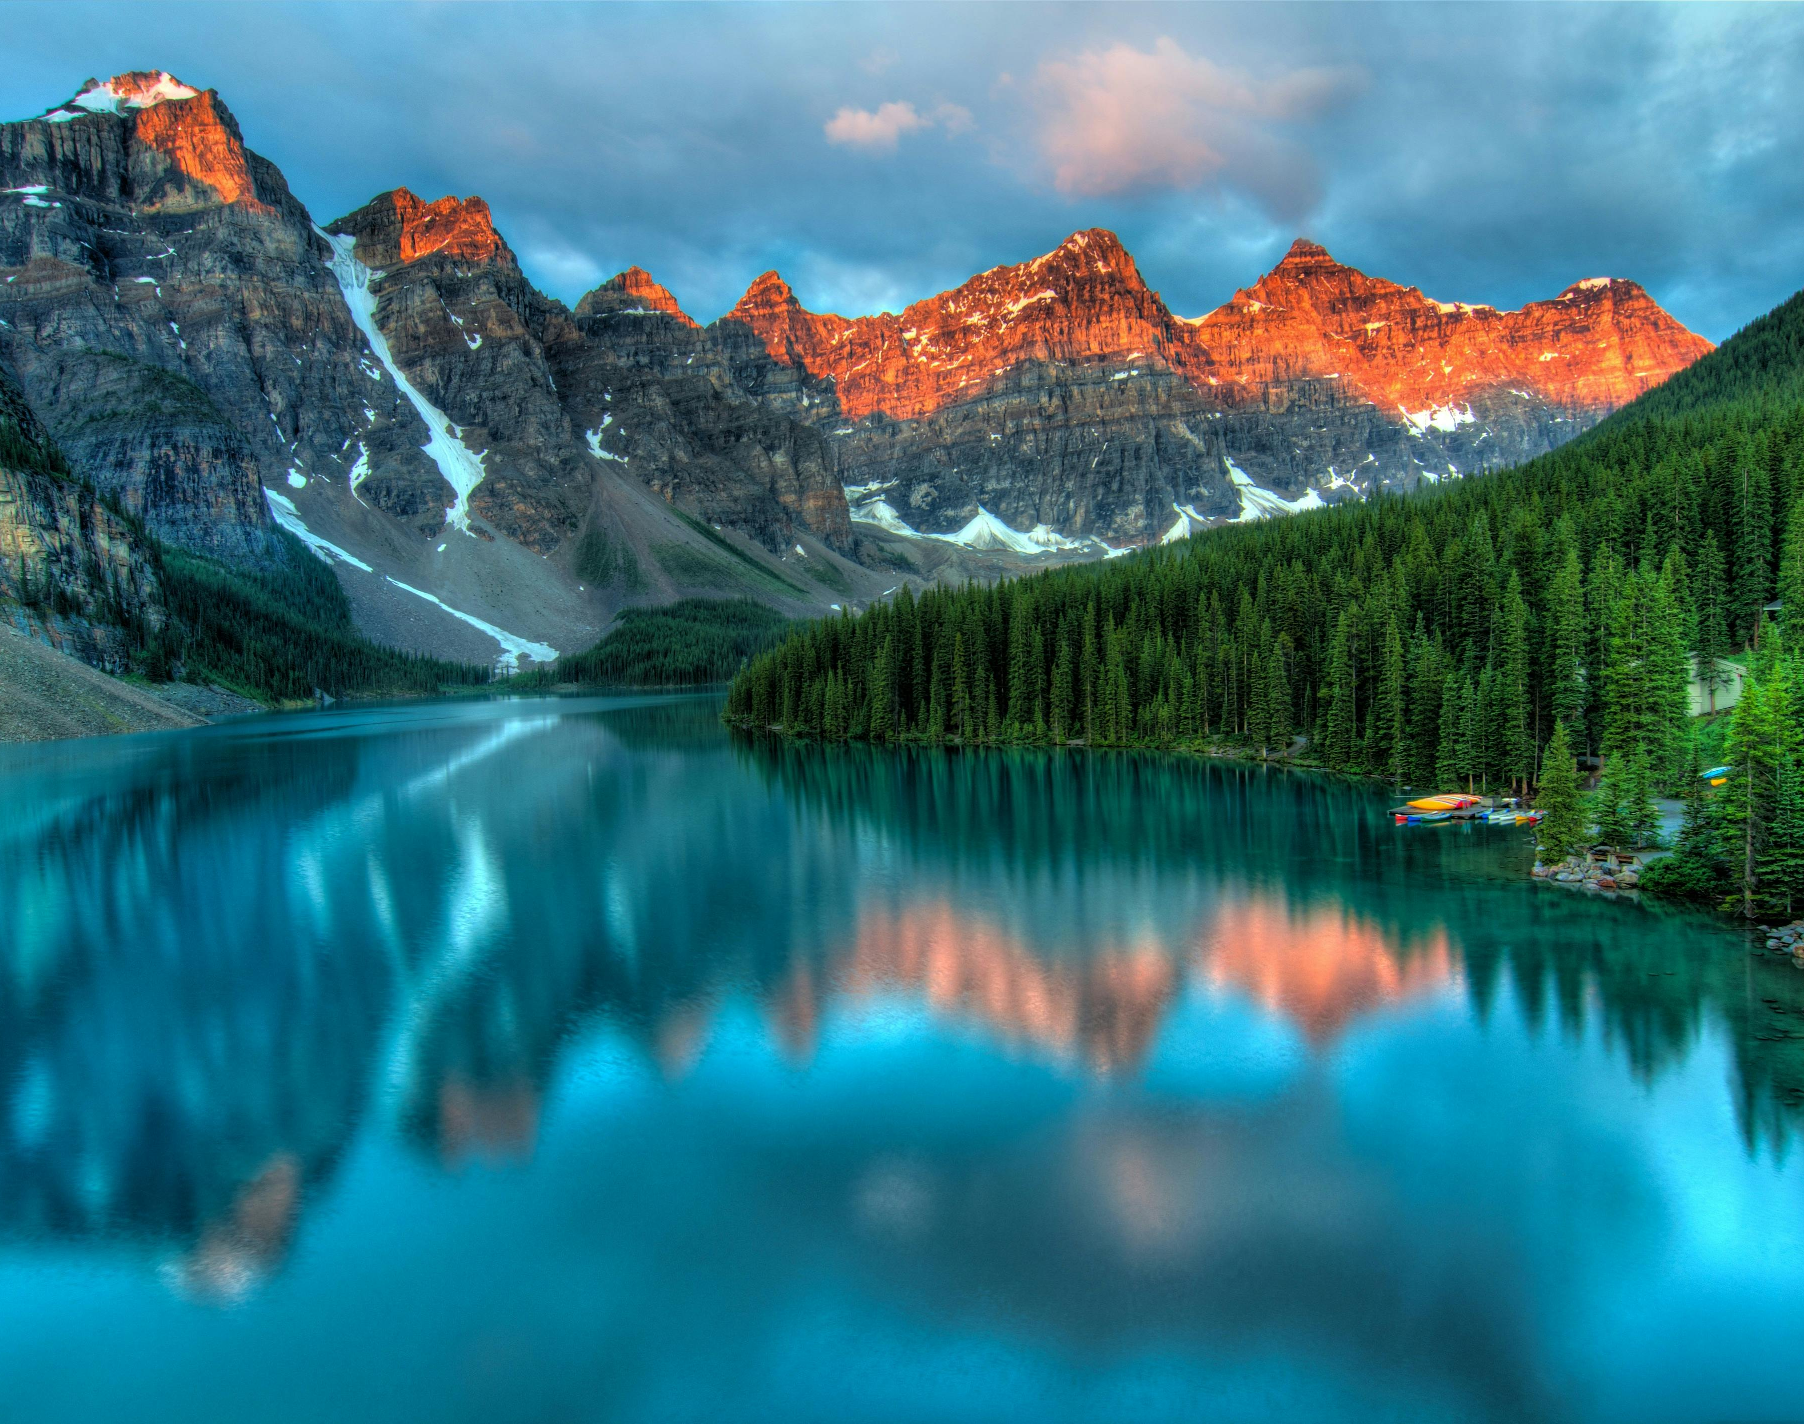
Switzerland
Famous for its picturesque Alps, Switzerland offers outdoor enthusiasts a paradise for hiking, skiing, and mountain biking.
The Swiss Alps provide stunning landscapes, and activities like paragliding in Interlaken or exploring the “Jungfraujoch” region offer a mix of thrill and beauty.

Slide 4
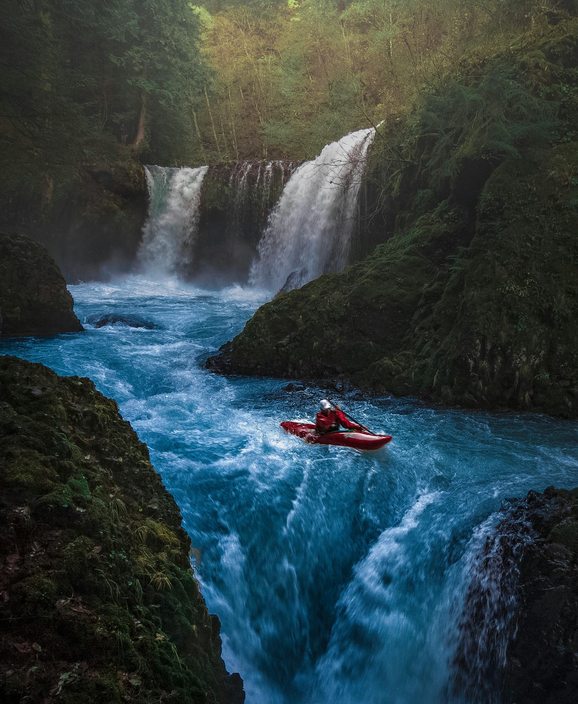
CANADA
Canada is renowned for its diverse and vast landscapes, from the rugged Rocky Mountains to the serene beauty of Banff National Park.
Adventure seekers can enjoy activities such as kayaking in British Columbia, hiking in the Rockies, and exploring the vibrant cities of Vancouver and Toronto.

Slide 5
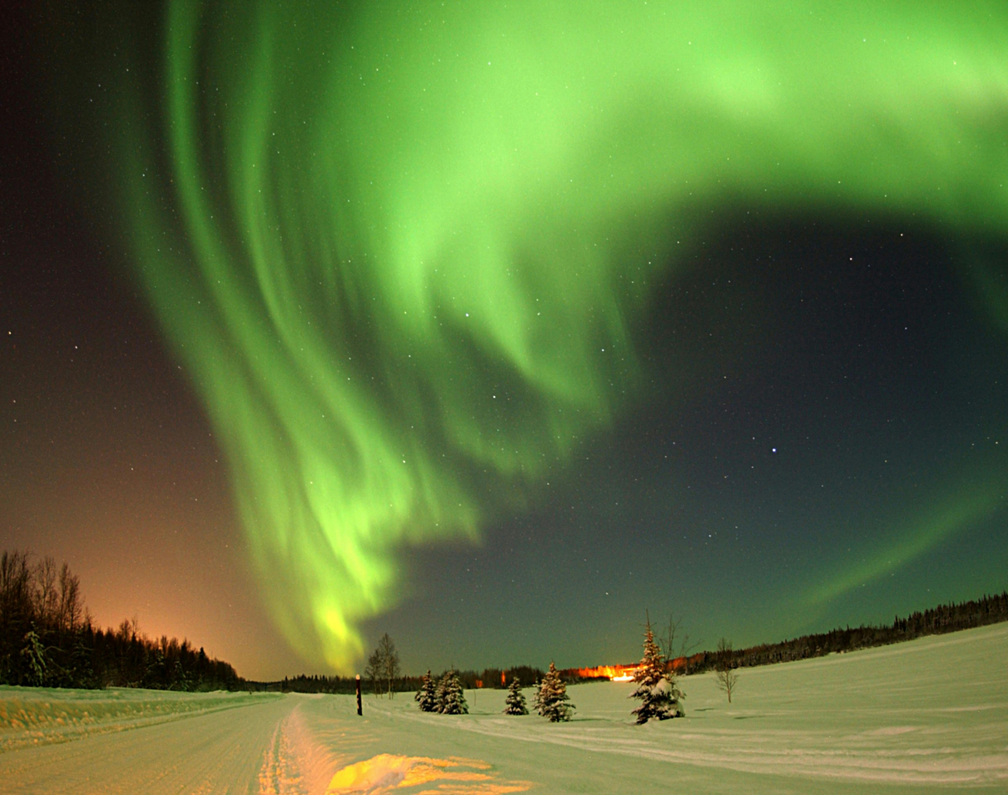
NORWAY
Norway's fjords, waterfalls, and northern lights make it a visually stunning destination.
Adventure opportunities include hiking in the Norwegian wilderness, cruising the dramatic Geirangerfjord, and experiencing the midnight sun in the Arctic Circle.

Slide 6
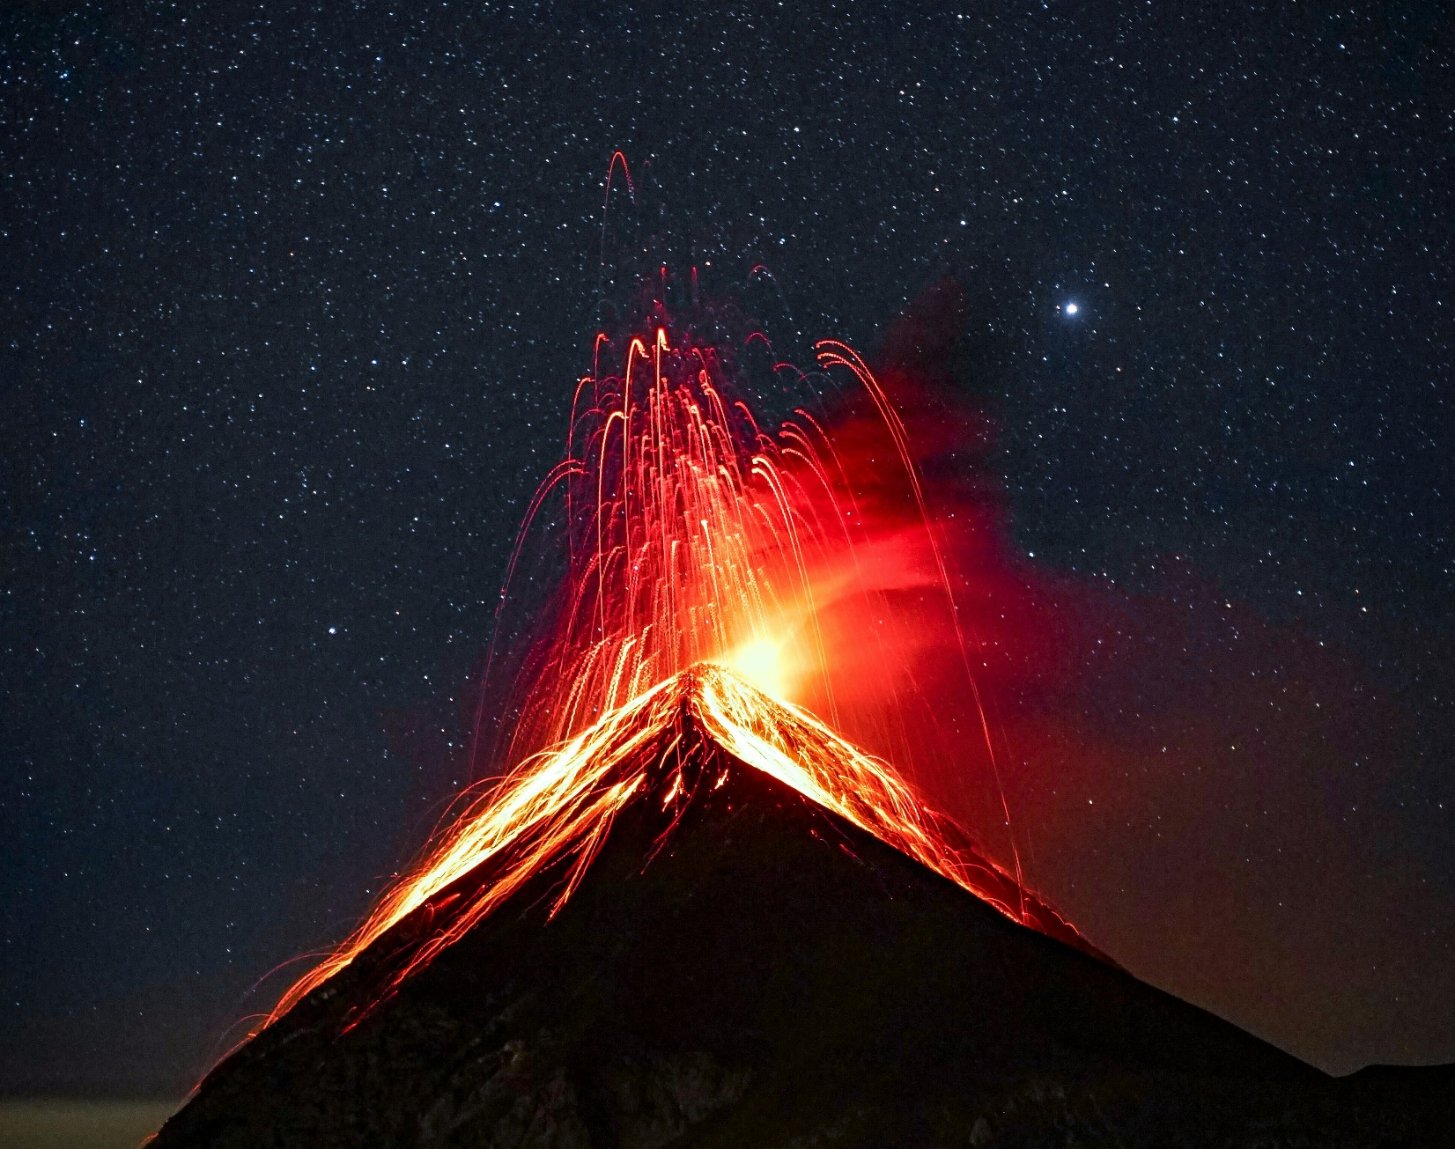
Costa Rica
Costa Rica is a tropical paradise known for its lush rainforests, volcanoes, and pristine beaches.
Adventure seekers can enjoy activities like zip-lining through the Monteverde Cloud Forest, hiking the Arenal Volcano, and surfing in the Pacific or Caribbean coasts
“Life is either a daring adventure or nothing at all.” ― Helen Keller

